Slide 1
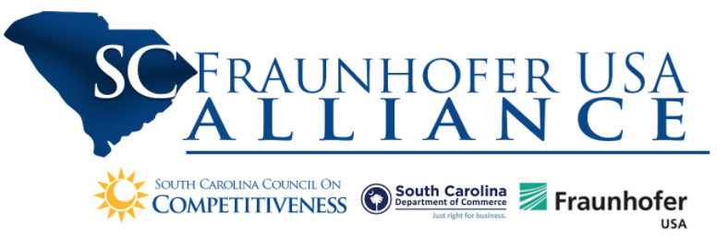



Proactive and Automated Control for BMW

Slide 2
Project Team
BMW: Andrej Erkelens, Liliana Banda, Allen Godsey, Justin Hayes, Ken Kennedy, Vincent Wideman, Josh Abel, Shawn Mangiafico
UofSC:
McNair Aerospace Center: Abdel Bayoumi, Rhea Matthews, Evan Meaney, Andre Calderon
AI Institute: Amit Sheth, Pankesh Patel, Forest Agostinelli, RJ Gleaton, Ashik Kumar
Fraunhofer: Jeno Szep, Brook Stacy, Michael Miller, Prahlad Menon

Slide 3
Problem Statement
Challenge
BMW assembly processes integrate thousands of parts, sourced from a wide variety of suppliers, located around the world
If these parts fail to arrive on time, costly delays and work stoppages follow
Requires monitoring that is done manually by highly experienced supply chain professionals
Tedious and expensive
Solution
Improved data-driven algorithms, systems and processes
Capture, analyze and exploit datasets to enable optimized and proactive materials control, optimize specialized human expertise, and reduce line stoppages due to missing parts
Scalable

Slide 4
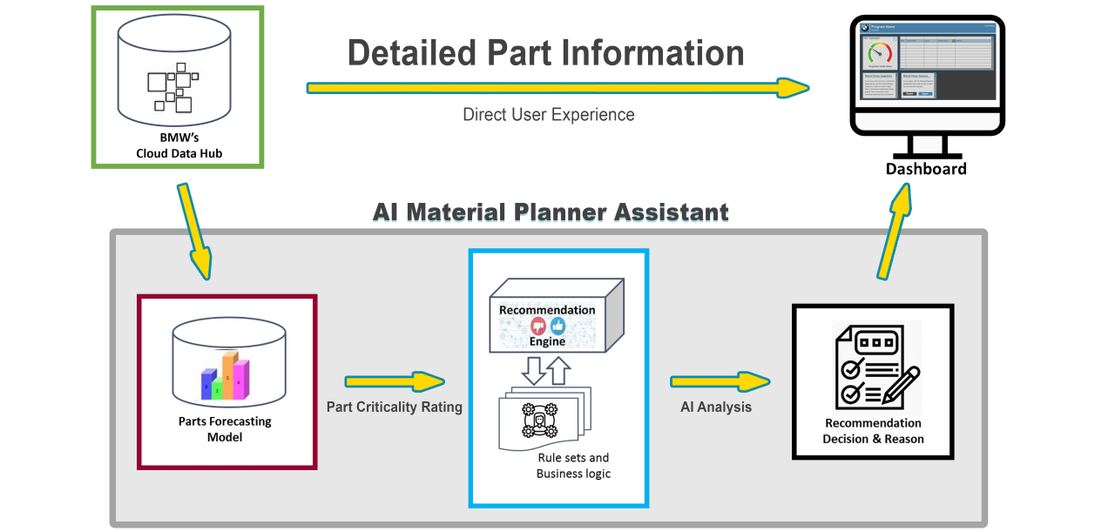
Material Planner Assistant

Slide 5
Data
Collected Datasets
User Documentation
Interviews
130 Reports
Zgrve Reports
MD04 Reports
Cloud Data Hub
Logan Prepared
Material Master Planner
MC10/TS-12x
User Manual Bulk Planning Process
Understand the Planner’s daily tasks and the processes used to assess risk and make decisions
Identify commonly used features
Identify what capabilities would be helpful in a dashboard
Identify logic of current SAP system

Slide 6
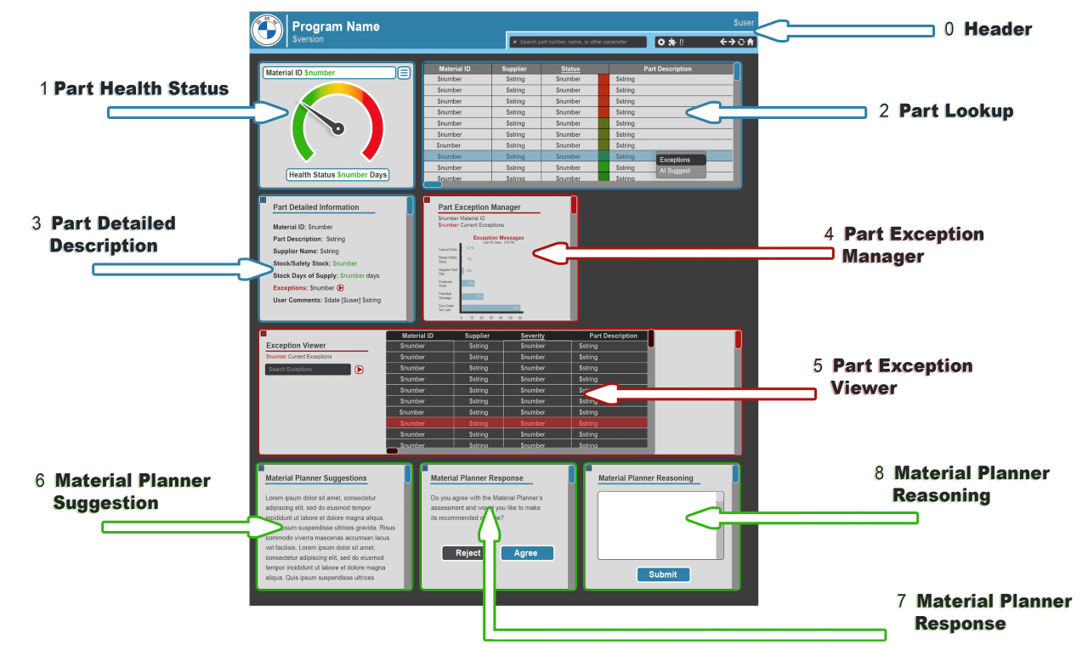
User Dashboards

Slide 7
Health Score Algorithm
Cloud Data Hub
Health Score
Stock
Health Score Model
Health
Score
x
Safety Stock
…
Contributing Factors (Phase 2)
Demand
Inputs
Outputs

Slide 8
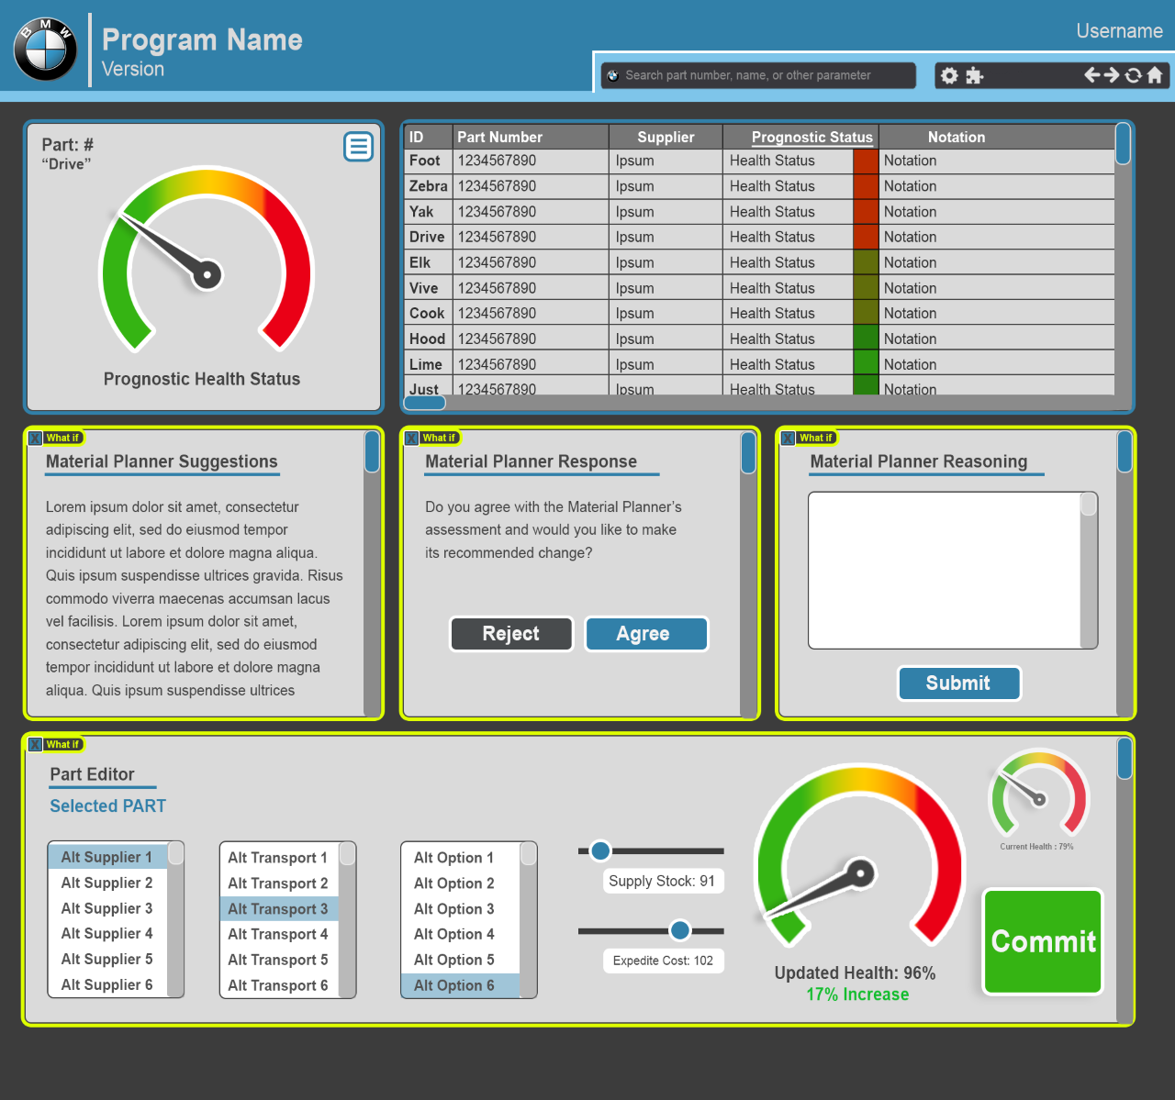
Recommendation Engine - Concepts
Execution Steps
1. Input
(Material Planner #, part #)
2. Evaluate
(apply business rules)
3. Decide
(propose recommendation)
4. Output
(recommendations
on dashboard)
Parts database
Properties
Rule-Based Expert System
Based on DROOLS.NET
Separates logic from application
Maintainable
Scalable
Analysis
Recomm. Engine

Slide 9
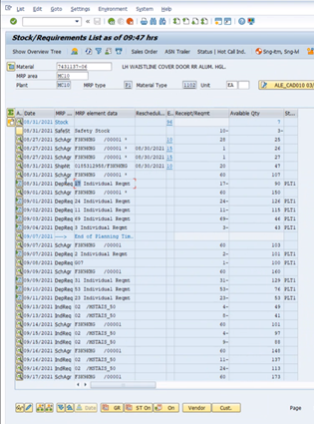
Recommendation Engine - Example Case
#11 “Inventory On Hand Is Below Safety Stock”
1. Data Input
2. Evaluate
3. Decide
Run business rules on data
Detect: The available quantity for today is less than the demand for today and tomorrow
Propose:
“Urgent expedite order is required. Expedite order quantity should cover production for today and tomorrow.”

Slide 10
Benefits
 | Current State | Material Planner Assistant (MPA) | Benefits
Dashboard | A significant amount of time is spent in reviewing information such as exception messages | All related material information is located in one easy to navigate dashboard | Provide Key Performance Indicators (KPIs) (e.g., health score) to guide a material planner and reduce their daily efforts Improve quality decisions made by reducing overall number of exceptions. Optimized decision making to reduce stoppages and delays (cost and time savings) Reduce number of emergency orders (cost savings) Implement and standardize best practices across groups
 |  | Collects material planner’s knowledge by requesting feedback on the MPA’s recommendation | Material planner feedback on recommendations can be used to refine and improve MPA
 |  | Material planners to look at trends related to their parts along with key performance indicators and abstractions
Health Score Model | Current designation on criticality of parts is red/yellow/green with no additional information. | Provides an informative score (0-100) on the criticality of parts along with contributing factors | Material planners are more informed on the which parts need attention immediately and why. This leads to more accurate decisions in preventing delays and costs
Recommendation Engine | Lack of standardization, individual planners employ varying strategies | Codify material planning knowledge into rules | Implement best practices across material planner groups and provides baseline consistency
Overall: Address the gap between SAP and material planner practice

Slide 11
Future Work and Applications
Expansion of MPA project
Further enhancements to recommendation engine and health score model
Expanding to different classifications of parts
Exploration of other areas in supply chain that need optimization
Team has gained a solid foundation of understanding current datasets
Dashboards for training

Slide 12
Video

